Slide 1
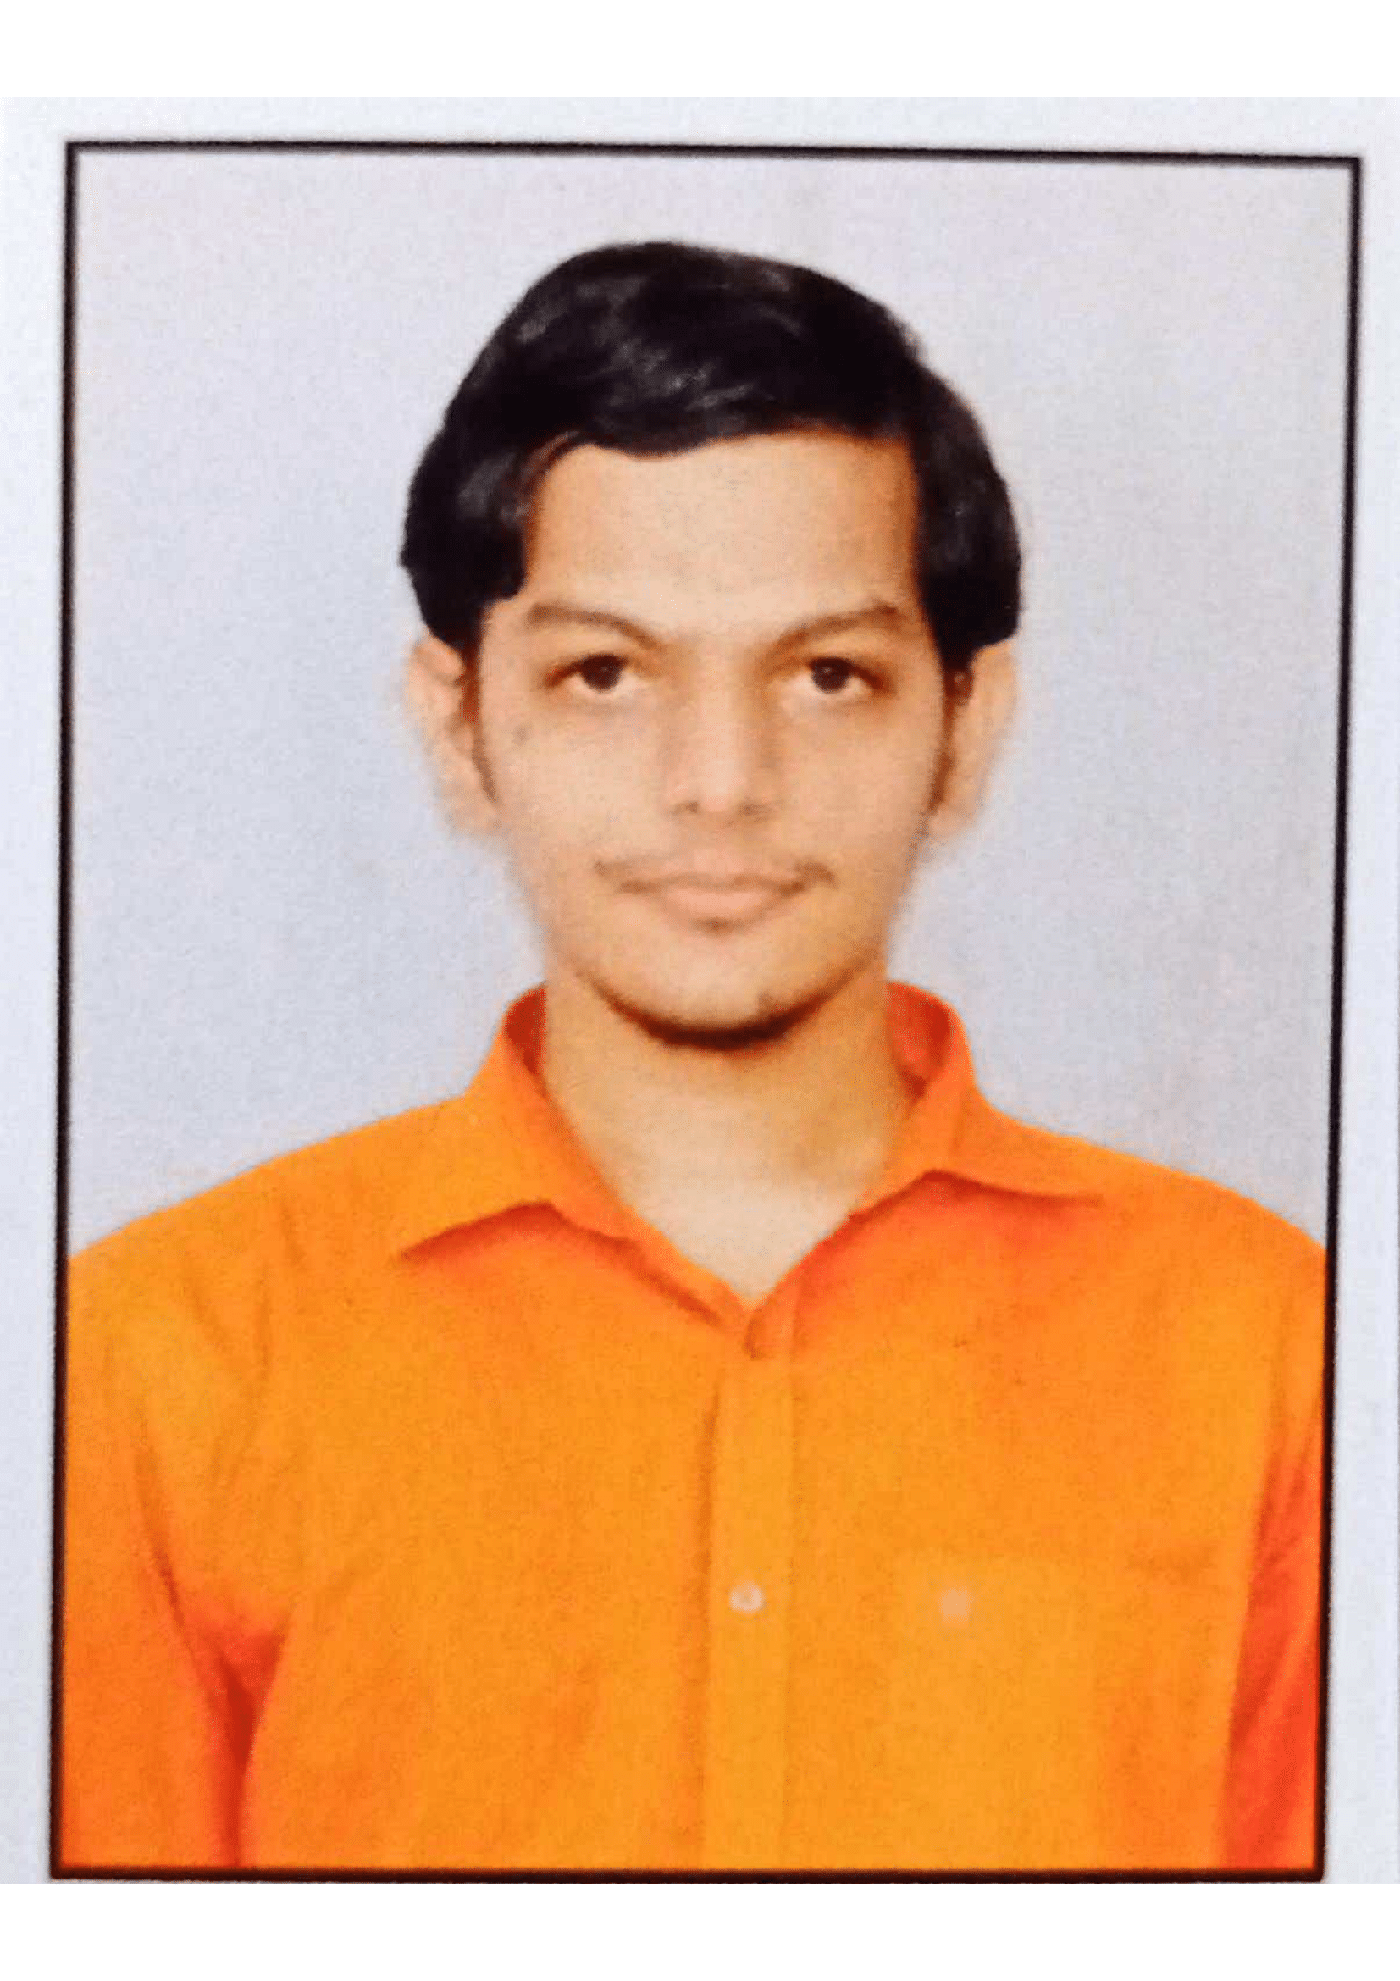


SAINIKHIL GODLAVETI
Analyst/Software Engineer
BACHELOR OF ENGINEERING
Electronics and Communication Engineering:2017-2021
Skills C#
Dot net core
ADO. Net
ASP. Net Core MVC
Python
Pandas
Data Wrangling
Database
MS SQL Server 2014
AddOns
Github
Postman
Additional skills
Quick Learner
Team Management
BANGALORE
Sainikhil.godlaveti@capgemini.com
+91 7036404155
A4
Eager to work in a team of dedicated people and serve a key role in the enhancement and development of the project.
Ready to learn new technologies and implement them to further improve my knowledge.
Had working experience in Data science technology and am more eager to explore my knowledge in that technology.
Online Recipe Ingrediant Management System :
Completed end to end case study of Online Recipe Ingrediant management System along with Swagger. html, CSS for user interface.
Completed Microsoft Azure Fundamentals Certificate
Completed Python Data Science Certification
Check out my work on GitHub & Video Profile

